Slide 1
Chapter 1 - Introduction

Slide 2
Outline
Fundamental concepts – to set up the framework for computer security
Access Control Models – who has access?
Cryptographic concepts – protect the data
Implementation and usability

Slide 3
Defining Security
The security of a system, application, or protocol is always relative to
A set of desired properties
An adversary with specific capabilities
For example, standard file access permissions in Linux and Windows are not effective against an adversary who can boot from a CD

Slide 4

Security Goals
Integrity
C.I.A.
Confidentiality
Availability

Slide 5
Confidentiality
Confidentiality is the avoidance of the unauthorized disclosure of information.
confidentiality involves the protection of data, providing access for those who are allowed to see it while disallowing others from learning anything about its content.

Slide 6
Tools for Confidentiality
Encryption: the transformation of information using a secret, called an encryption key, so that the transformed information can only be read using another secret, called the decryption key (which may, in some cases, be the same as the encryption key).
Sender
Communication channel
Recipient
encrypt
decrypt
ciphertext
plaintext
plaintext
shared
secret
key
shared
secret
key
Attacker
(eavesdropping)

Slide 7
Tools for Confidentiality
Access control: rules and policies that limit access to confidential information to those people and/or systems with a “need to know.”
This need to know may be determined by identity, such as a person’s name or a computer’s serial number, or by a role that a person has, such as being a manager or a computer security specialist.

Slide 8
Tools for Confidentiality
Authentication: the determination of the identity or role that someone has. This determination can be done in a number of different ways, but it is usually based on a combination of
something the person has (like a smart card or a radio key fob storing secret keys),
something the person knows (like a password),
something the person is (like a human with a fingerprint).
password=ucIb()w1V
mother=Jones
pet=Caesar
human with fingers
and eyes
Something you are
Something you know
radio token with
secret keys
Something you have

Slide 9
Tools for Confidentiality
Authorization: the determination if a person or system is allowed access to resources, based on an access control policy.
Such authorizations should prevent an attacker from tricking the system into letting him have access to protected resources.

Slide 10
Tools for Confidentiality
Physical security: the establishment of physical barriers to limit access to protected computational resources.
Such barriers include locks on cabinets and doors, the placement of computers in windowless rooms, the use of sound dampening materials, and even the construction of buildings or rooms with walls incorporating copper meshes (called Faraday cages) so that electromagnetic signals cannot enter or exit the enclosure.

Slide 11
Integrity
Integrity: the property that information has not be altered in an unauthorized way.
Tools:
Backups: the periodic archiving of data.
Checksums: the computation of a function that maps the contents of a file to a numerical value. A checksum function depends on the entire contents of a file and is designed in a way that even a small change to the input file (such as flipping a single bit) is highly likely to result in a different output value.
Data correcting codes: methods for storing data in such a way that small changes can be easily detected and automatically corrected.

Slide 12
Availability
Availability: the property that information is accessible and modifiable in a timely fashion by those authorized to do so.
Tools:
Physical protections: infrastructure meant to keep information available even in the event of physical challenges.
Computational redundancies: computers and storage devices that serve as fallbacks in the case of failures.

Slide 13
Other Security Concepts
A.A.A.
Authenticity
Anonymity
Assurance

Slide 14
Assurance
Assurance refers to how trust is provided and managed in computer systems.
Trust management depends on:
Policies, which specify behavioral expectations that people or systems have for themselves and others.
For example, the designers of an online music system may specify policies that describe how users can access and copy songs.
Permissions, which describe the behaviors that are allowed by the agents that interact with a person or system.
For instance, an online music store may provide permissions for limited access and copying to people who have purchased certain songs.
Protections, which describe mechanisms put in place to enforce permissions and polices.
We could imagine that an online music store would build in protections to prevent people from unauthorized access and copying of its songs.

Slide 15
Authenticity
Authenticity is the ability to determine that statements, policies, and permissions issued by persons or systems are genuine.
Primary tool:
digital signatures. These are cryptographic computations that allow a person or system to commit to the authenticity of their documents in a unique way that achieves nonrepudiation, which is the property that authentic statements issued by some person or system cannot be denied.

Slide 16
Anonymity
Anonymity: the property that certain records or transactions not to be attributable to any individual.
Tools:
Aggregation: the combining of data from many individuals so that disclosed sums or averages cannot be tied to any individual.
Mixing: the intertwining of transactions, information, or communications in a way that cannot be traced to any individual.
Proxies: trusted agents that are willing to engage in actions for an individual in a way that cannot be traced back to that person.
Pseudonyms: fictional identities that can fill in for real identities in communications and transactions, but are otherwise known only to a trusted entity.

Slide 17
Threats and Attacks
Eavesdropping: the interception of information intended for someone else during its transmission over a communication channel.
Alice
Bob
Eve

Slide 18

Threats and Attacks
Alteration: unauthorized modification of information.
Example: the man-in-the-middle attack, where a network stream is intercepted, modified, and retransmitted.
Sender
Communication channel
Recipient
encrypt
decrypt
plaintext M
plaintext M′
shared
secret
key
shared
secret
key
ciphertext C
ciphertext C′
Attacker
(intercepting)

Slide 19
Threats and Attacks
Denial-of-service: the interruption or degradation of a data service or information access.
Example: email spam, to the degree that it is meant to simply fill up a mail queue and slow down an email server.
Alice

Slide 20
Threats and Attacks
Masquerading: the fabrication of information that is purported to be from someone who is not actually the author.
“From: Alice”
(really is from Eve)

Slide 21
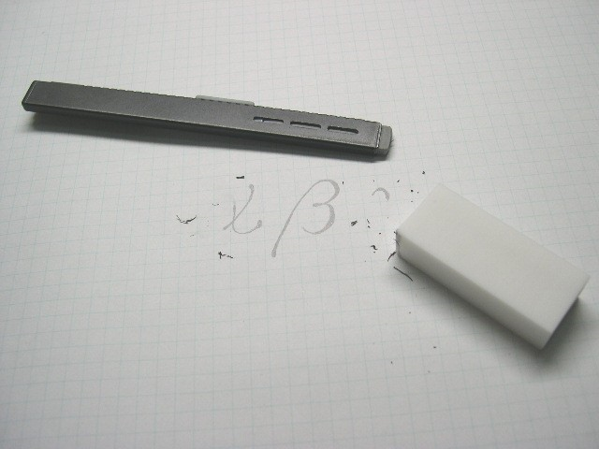
Threats and Attacks
Repudiation: the denial of a commitment or data receipt.
This involves an attempt to back out of a contract or a protocol that requires the different parties to provide receipts acknowledging that data has been received.
Public domain image from http://commons.wikimedia.org/wiki/File:Plastic_eraser.jpeg

Slide 22
Threats and Attacks
Correlation and traceback: the integration of multiple data sources and information flows to determine the source of a particular data stream or piece of information.
Bob

Slide 23
The Ten Security Principles
Security Principles
Economy of mechanism
Fail-safe defaults
Complete mediation
Open design
Separation of privilege
Least privilege
Least common mechanism
Psychological acceptability
Work factor
Compromise recording

Slide 24
Economy of mechanism
This principle stresses simplicity in the design and implementation of security measures.
While applicable to most engineering endeavors, the notion of simplicity is especially important in the security domain, since a simple security framework facilitates its understanding by developers and users and enables the efficient development and verification of enforcement methods for it.

Slide 25
Fail-safe defaults
This principle states that the default configuration of a system should have a conservative protection scheme.
For example, when adding a new user to an operating system, the default group of the user should have minimal access rights to files and services. Unfortunately, operating systems and applications often have default options that favor usability over security.
This has been historically the case for a number of popular applications, such as web browsers that allow the execution of code downloaded from the web server.

Slide 26
Complete mediation
The idea behind this principle is that every access to a resource must be checked for compliance with a protection scheme.
As a consequence, one should be wary of performance improvement techniques that save the results of previous authorization checks, since permissions can change over time.
For example, an online banking web site should require users to sign on again after a certain amount of time, say, 15 minutes, has elapsed.

Slide 27
Open design
According to this principle, the security architecture and design of a system should be made publicly available.
Security should rely only on keeping cryptographic keys secret.
Open design allows for a system to be scrutinized by multiple parties, which leads to the early discovery and correction of security vulnerabilities caused by design errors.
The open design principle is the opposite of the approach known as security by obscurity, which tries to achieve security by keeping cryptographic algorithms secret and which has been historically used without success by several organizations.

Slide 28
Separation of privilege
This principle dictates that multiple conditions should be required to achieve access to restricted resources or have a program perform some action.

Slide 29
Least privilege
Each program and user of a computer system should operate with the bare minimum privileges necessary to function properly.
If this principle is enforced, abuse of privileges is restricted, and the damage caused by the compromise of a particular application or user account is minimized.
The military concept of need-to-know information is an example of this principle.

Slide 30
Least common mechanism
In systems with multiple users, mechanisms allowing resources to be shared by more than one user should be minimized.
For example, if a file or application needs to be accessed by more than one user, then these users should have separate channels by which to access these resources, to prevent unforeseen consequences that could cause security problems.

Slide 31
Psychological acceptability
This principle states that user interfaces should be well designed and intuitive, and all security-related settings should adhere to what an ordinary user might expect.

Slide 32
Work factor
According to this principle, the cost of circumventing a security mechanism should be compared with the resources of an attacker when designing a security scheme.
A system developed to protect student grades in a university database, which may be attacked by snoopers or students trying to change their grades, probably needs less sophisticated security measures than a system built to protect military secrets, which may be attacked by government intelligence organizations.

Slide 33
Compromise recording
This principle states that sometimes it is more desirable to record the details of an intrusion than to adopt more sophisticated measures to prevent it.
Internet-connected surveillance cameras are a typical example of an effective compromise record system that can be deployed to protect a building in lieu of reinforcing doors and windows.
The servers in an office network may maintain logs for all accesses to files, all emails sent and received, and all web browsing sessions.

Slide 34
Topic: Access Control
Users and groups
Authentication
Passwords
File protection
Access control lists
Which users can read/write which files?
Are my files really safe?
What does it mean to be root?
What do we really want to control?

Slide 35
Access Control Matrices
A table that defines permissions.
Each row of this table is associated with a subject, which is a user, group, or system that can perform actions.
Each column of the table is associated with an object, which is a file, directory, document, device, resource, or any other entity for which we want to define access rights.
Each cell of the table is then filled with the access rights for the associated combination of subject and object.
Access rights can include actions such as reading, writing, copying, executing, deleting, and annotating.
An empty cell means that no access rights are granted.

Slide 36
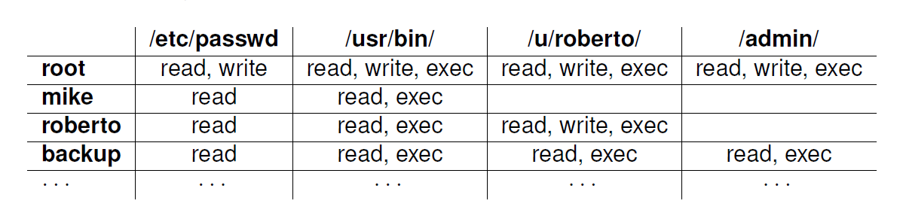
Example Access Control Matrix

Slide 37
Access Control Lists
It defines, for each object, o, a list, L, called o’s access control list, which enumerates all the subjects that have access rights for o and, for each such subject, s, gives the access rights that s has for object o.
/etc/passwd
/usr/bin/
/u/roberto/
/admin/
root: r,w
mike: r
roberto: r
backup: r
root: r,w,x
mike: r,x
roberto: r,x
backup: r,x
root: r,w,x
roberto: r,w,x
backup: r,x
root: r,w,x
backup: r,x

Slide 38
Capabilities
/etc/passwd: r,w,x; /usr/bin: r,w,x;
/u/roberto: r,w,x; /admin/: r,w,x
root
Takes a subject-centered approach to access control. It defines, for each subject s, the list of the objects for which s has nonempty access control rights, together with the specific rights for each such object.
mike
/usr/passwd: r; /usr/bin: r,x
/usr/passwd: r; /usr/bin: r;
/u/roberto: r,w,x
roberto
/etc/passwd: r,x; /usr/bin: r,x;
/u/roberto: r,x; /admin/: r,x
backup

Slide 39
Role-based Access Control
Define roles and then specify access control rights for these roles, rather than for subjects directly.
Department Chair
Administrative Manager
Lab Manager
System Administrator
Undergraduate TA
Graduate TA
Accountant
Secretary
Lab Technician
Backup Agent
Undergraduate Student
Graduate Student
Administrative Personnel
Technical Personnel
Faculty
Student
Department Member

Slide 40
Cryptographic Concepts
Encryption: a means to allow two parties, customarily called Alice and Bob, to establish confidential communication over an insecure channel that is subject to eavesdropping.
Alice
Bob
Eve

Slide 41
Encryption and Decryption
The message M is called the plaintext.
Alice will convert plaintext M to an encrypted form using an encryption algorithm E that outputs a ciphertext C for M.
Sender
Communication channel
Recipient
encrypt
decrypt
ciphertext
plaintext
plaintext
shared
secret
key
shared
secret
key
Attacker
(eavesdropping)

Slide 42
Encryption and Decryption
As equations:
C = E(M)
M = D(C)
The encryption and decryption algorithms are chosen so that it is infeasible for someone other than Alice and Bob to determine plaintext M from ciphertext C. Thus, ciphertext C can be transmitted over an insecure channel that can be eavesdropped by an adversary.

Slide 43
Cryptosystem
The set of possible plaintexts
The set of possible ciphertexts
The set of encryption keys
The set of decryption keys
The correspondence between encryption keys and decryption keys
The encryption algorithm to use
The decryption algorithm to use

Slide 44
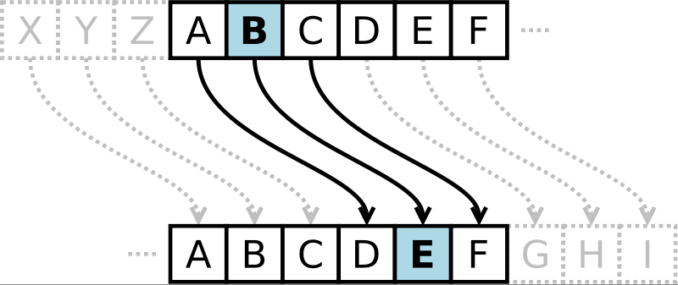
Caesar Cipher
Replace each letter with the one “three over” in the alphabet.
Public domain image from http://commons.wikimedia.org/wiki/File:Caesar3.svg

Slide 45
Symmetric Cryptosystems
Alice and Bob share a secret key, which is used for both encryption and decryption.
Sender
Communication channel
Recipient
encrypt
decrypt
ciphertext
plaintext
plaintext
shared
secret
key
shared
secret
key
Attacker
(eavesdropping)

Slide 46
Symmetric Key Distribution
Requires each pair of communicating parties to share a (separate) secret key.
shared
secret
shared
secret
shared
secret
shared
secret
shared
secret
n (n−1)/2 keys
shared
secret

Slide 47
Public-Key Cryptography
Bob has two keys: a private key, SB, which Bob keeps secret, and a public key, PB, which Bob broadcasts widely.
In order for Alice to send an encrypted message to Bob, she need only obtain his public key, PB, use that to encrypt her message, M, and send the result, C = E_{PB} (M), to Bob. Bob then uses his secret key to decrypt the message as M = D_{SB} (C).

Slide 48
Public-Key Cryptography
Separate keys are used for encryption and decryption.
Communication channel
Sender
Recipient
encrypt
decrypt
plaintext
ciphertext
plaintext
plaintext
public
key
private
key
Attacker
(eavesdropping)

Slide 49
Public Key Distribution
Only one key is needed for each recipient
private
private
public
public
n key pairs
public
public
private
private

Slide 50
Digital Signatures
Public-key encryption provides a method for doing digital signatures
To sign a message, M, Alice just encrypts it with her private key, SA, creating C = E_{SA}(M).
Anyone can decrypt this message using Alice’s public key, as M’ = D_{PA}(C), and compare that to the message M.

Slide 51
Cryptographic Hash Functions
A checksum on a message, M, that is:
One-way: it should be easy to compute Y=H(M), but hard to find M given only Y
Collision-resistant: it should be hard to find two messages, M and N, such that H(M)=H(N).
Examples: SHA-1, SHA-256.

Slide 52
Message Authentication Codes
Allows for Alice and Bob to have data integrity, if they share a secret key.
Given a message M, Alice computes H(K||M) and sends M and this hash to Bob.
Communication channel
(attack detected) =?
h
6B34339
4C66809
4C66809
87F9024
h
message M
MAC
MAC
received MAC
computed MAC
message M’
shared
secret
key
shared
secret
key
Sender
Attacker
(modifying)
Recipient

Slide 53
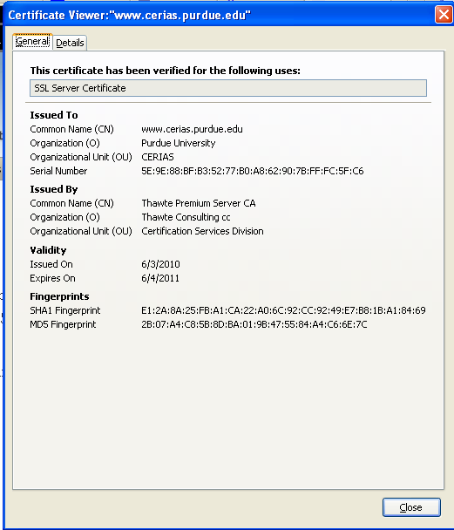
Digital Certificates
certificate authority (CA) digitally signs a binding between an identity and the public key for that identity.

Slide 54
Passwords
A short sequence of characters used as a means to authenticate someone via a secret that they know.
Userid: _________________
Password: ______________

Slide 55
How a password is stored?
User
Password file
Dog124
Butch:ASDSA
21QW3R50E
ERWWER323
…
…
hash function

Slide 56
Strong Passwords
What is a strong password
UPPER/lower case characters
Special characters
Numbers
When is a password strong?
Seattle1
M1ke03
P@$$w0rd
TD2k5secV
56
Notes:
56
56
Spostare in altra sezione

Slide 57
Password Complexity
A fixed 6 symbols password:
Numbers 10⁶ = 1,000,000
UPPER or lower case characters 26⁶ = 308,915,776
UPPER and lower case characters 52⁶ = 19,770,609,664
32 special characters (&, %, $, £, “, |, ^, §, etc.) 32⁶ = 1,073,741,824
94 practical symbols available
94⁶ = 689,869,781,056
ASCII standard 7 bit 2⁷ =128 symbols
128⁶ = 4,398,046,511,104
57

Slide 58

Password Length
26 UPPER/lower case characters = 52 characters
10 numbers
32 special characters
=> 94 characters available
5 characters: 94⁵ = 7,339,040,224
6 characters: 94⁶ = 689,869,781,056
7 characters: 94⁷ = 64,847,759,419,264
8 characters: 94⁸ = 6,095,689,385,410,816
9 characters: 94⁹ = 572,994,802,228,616,704
58
Notes:
58
58

Slide 59
Password Validity: Brute Force Test
Password does not change for 60 days
how many passwords should I try for each second?
5 characters: 1,415 PW /sec
6 characters: 133,076 PW /sec
7 characters: 12,509,214 PW /sec
8 characters: 1,175,866,008 PW /sec
9 characters: 110,531,404,750 PW /sec
59
Notes:
59
59

Slide 60
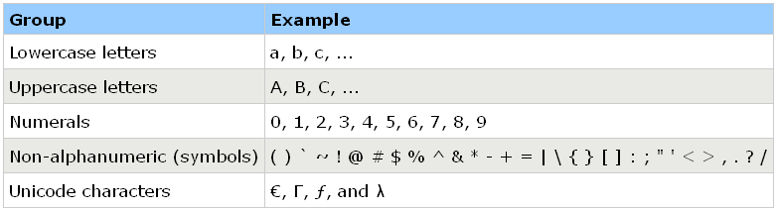
Secure Passwords
A strong password includes characters from at least three of the following groups:
Use pass phrases eg. "I re@lly want to buy 11 Dogs!"
60

Slide 61
Social Engineering
Pretexting: creating a story that convinces an administrator or operator into revealing secret information.
Baiting: offering a kind of “gift” to get a user or agent to perform an insecure action.
Quid pro quo: offering an action or service and then expecting something in return.

